Slide 1
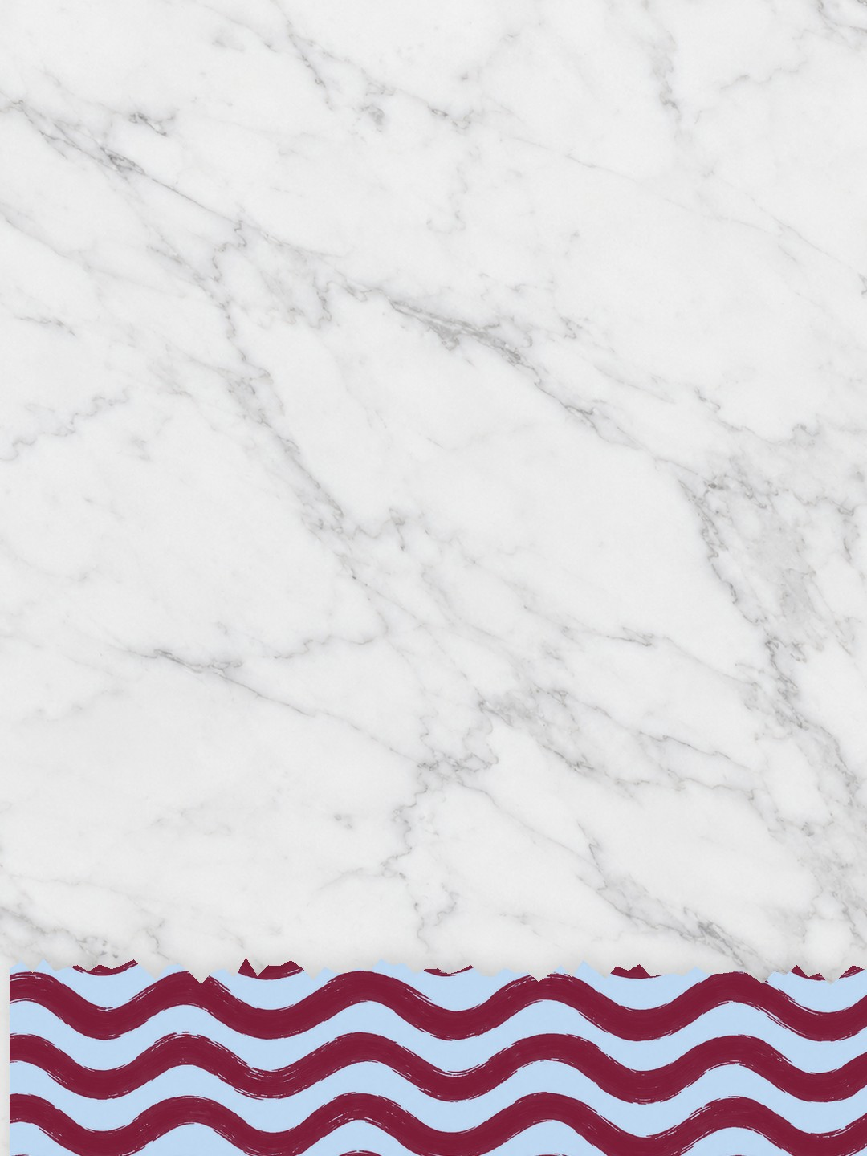



which one
are you?
A
B
Everything blue is a guide. Delete it before you download.
Notes:
Slide 1. Hook. Swap in a photo of version A (left) and version B (right). Edit their names.

Slide 2

[copper or
mint?]
[help me pick]
Notes:
Slide 2. Second hook: Instagram often shows a carousel starting on slide 2, so this one works as a cover on its own. No photo needed. Edit both [bracket] lines.

Slide 3


A: [Copper. Cordless.]
[so light]
Notes:
Slide 3. Version A: swap in its photo. Edit its name and the note.

Slide 4


B: [Mint. Steam-clean.]
Notes:
Slide 4. Version B: swap in its photo. Edit its name.

Slide 5



[two very different
moods]
B
A
Notes:
Slide 5. One photo of each version sits on the scale. Edit the line and both notes.

Slide 6
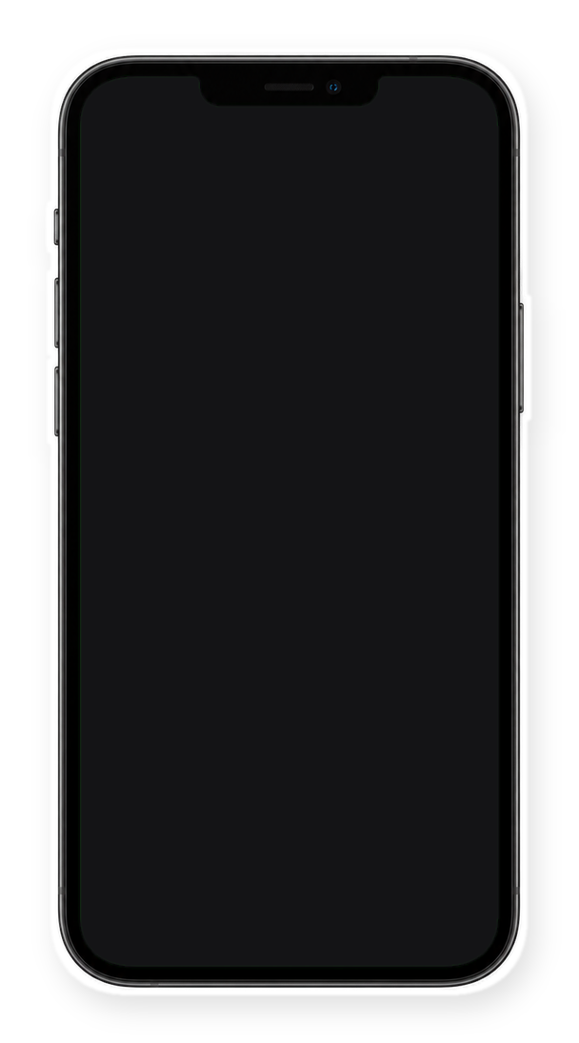


even my followers
can't pick
[A: 52%
B: 48%]
Notes:
Slide 6. Swap in a screenshot of your poll or comments for the phone screen. Edit the line.

Slide 7


Comment
"A" or "B"
[both in my shop]
Notes:
Slide 7. Swap in a photo of each version. Type your shop line. Caption to start from (CTA in the first two sentences, 3 hashtags): Comment [KEYWORD] and I will send you [the link]. [One line of real context: who it helps or how you use it.] #[tag] #[tag] #[tag]

